Slide 1
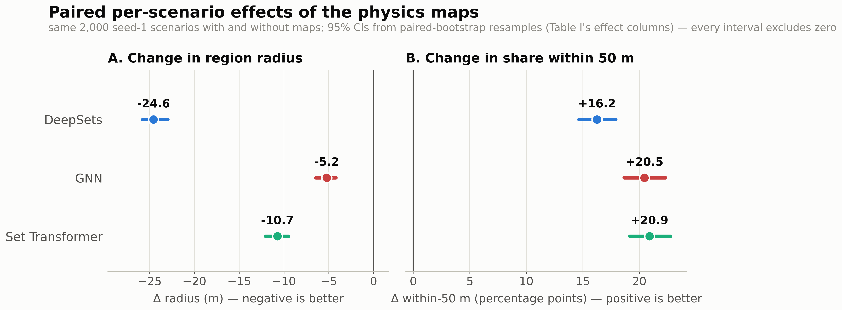
Adding the physics-derived maps shrinks the guaranteed search region for every architecture (−24.6 m DeepSets, −5.2 m GNN, −10.7 m Set Transformer) and raises the share of scenarios localized within 50 m by 16–21 percentage points. Every 95% confidence interval excludes zero.

Slide 2
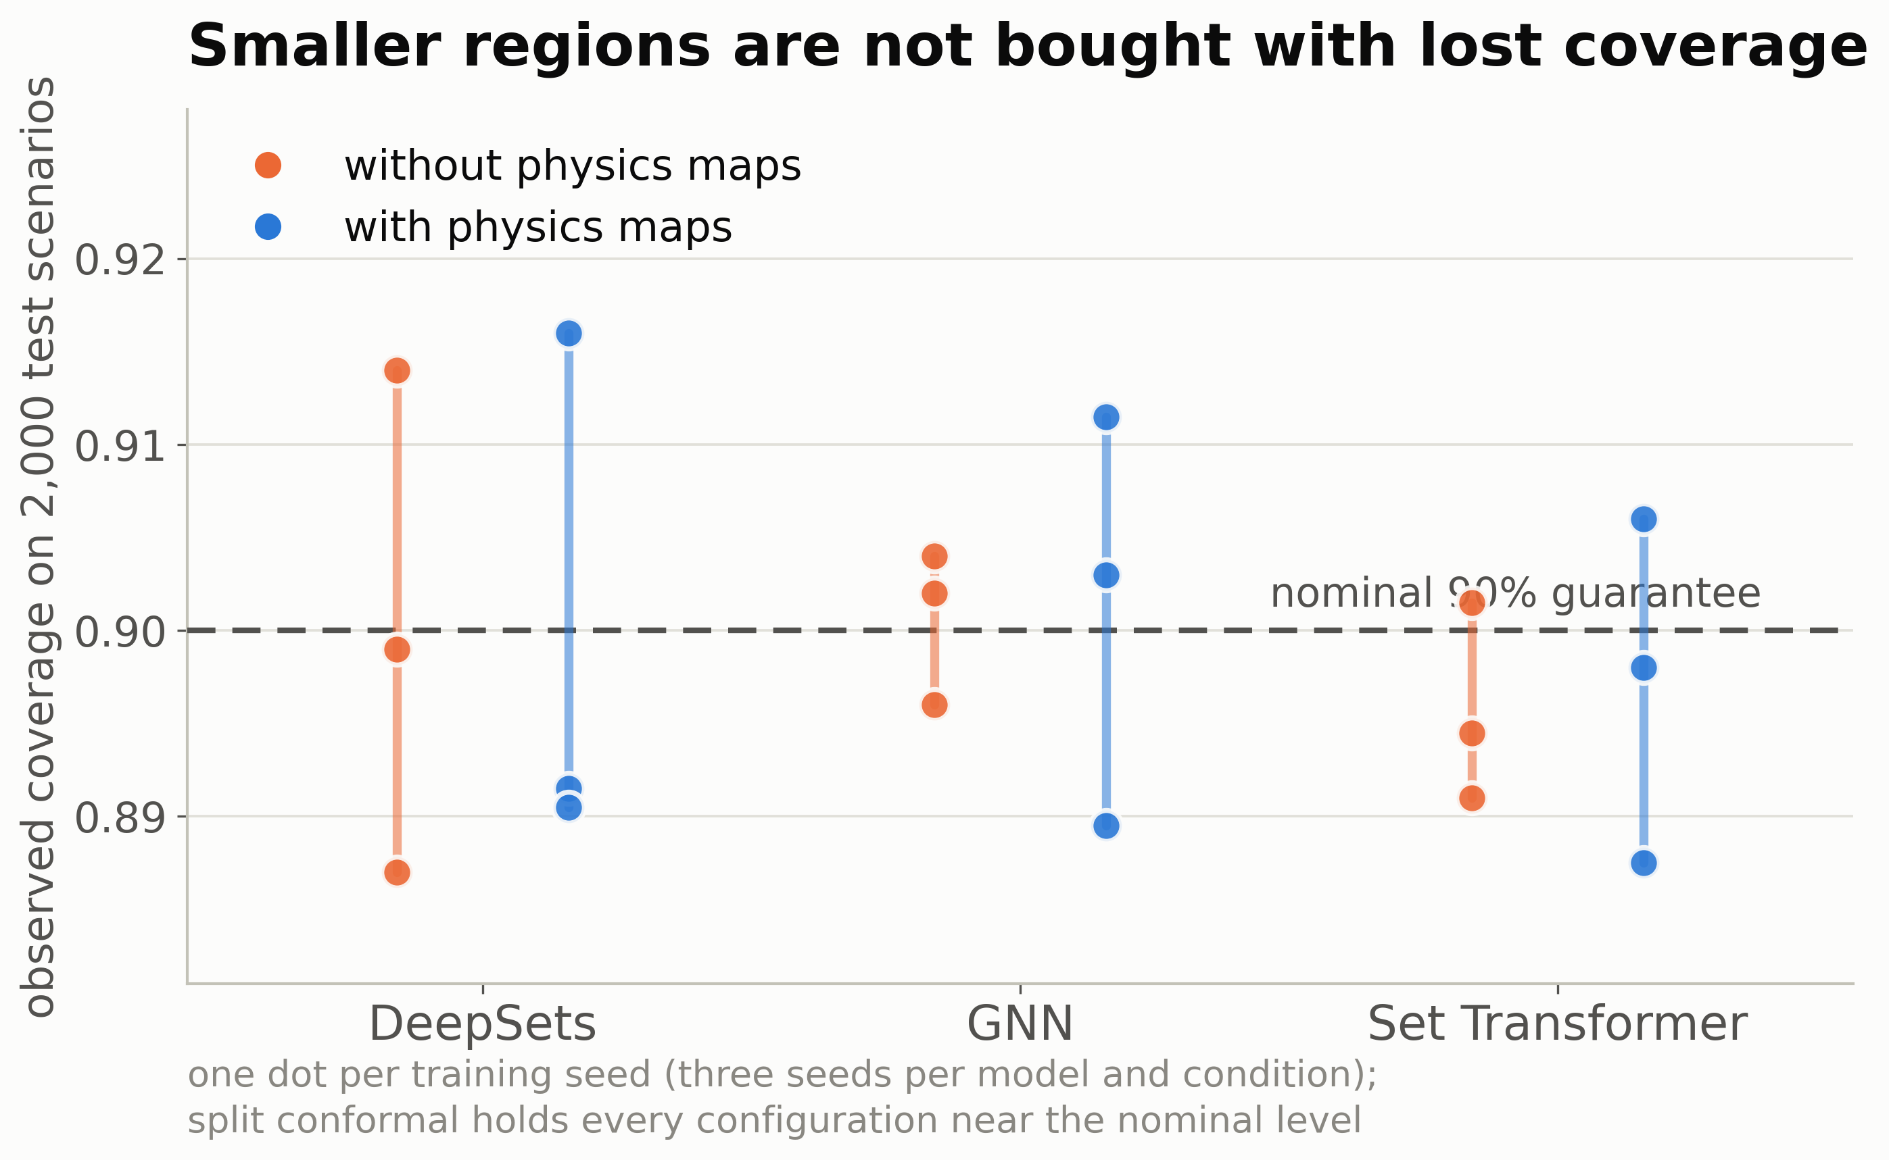
The smaller regions are not bought with lost reliability: observed coverage stays at the nominal 90% guarantee for every model, training seed, and condition.

Slide 3
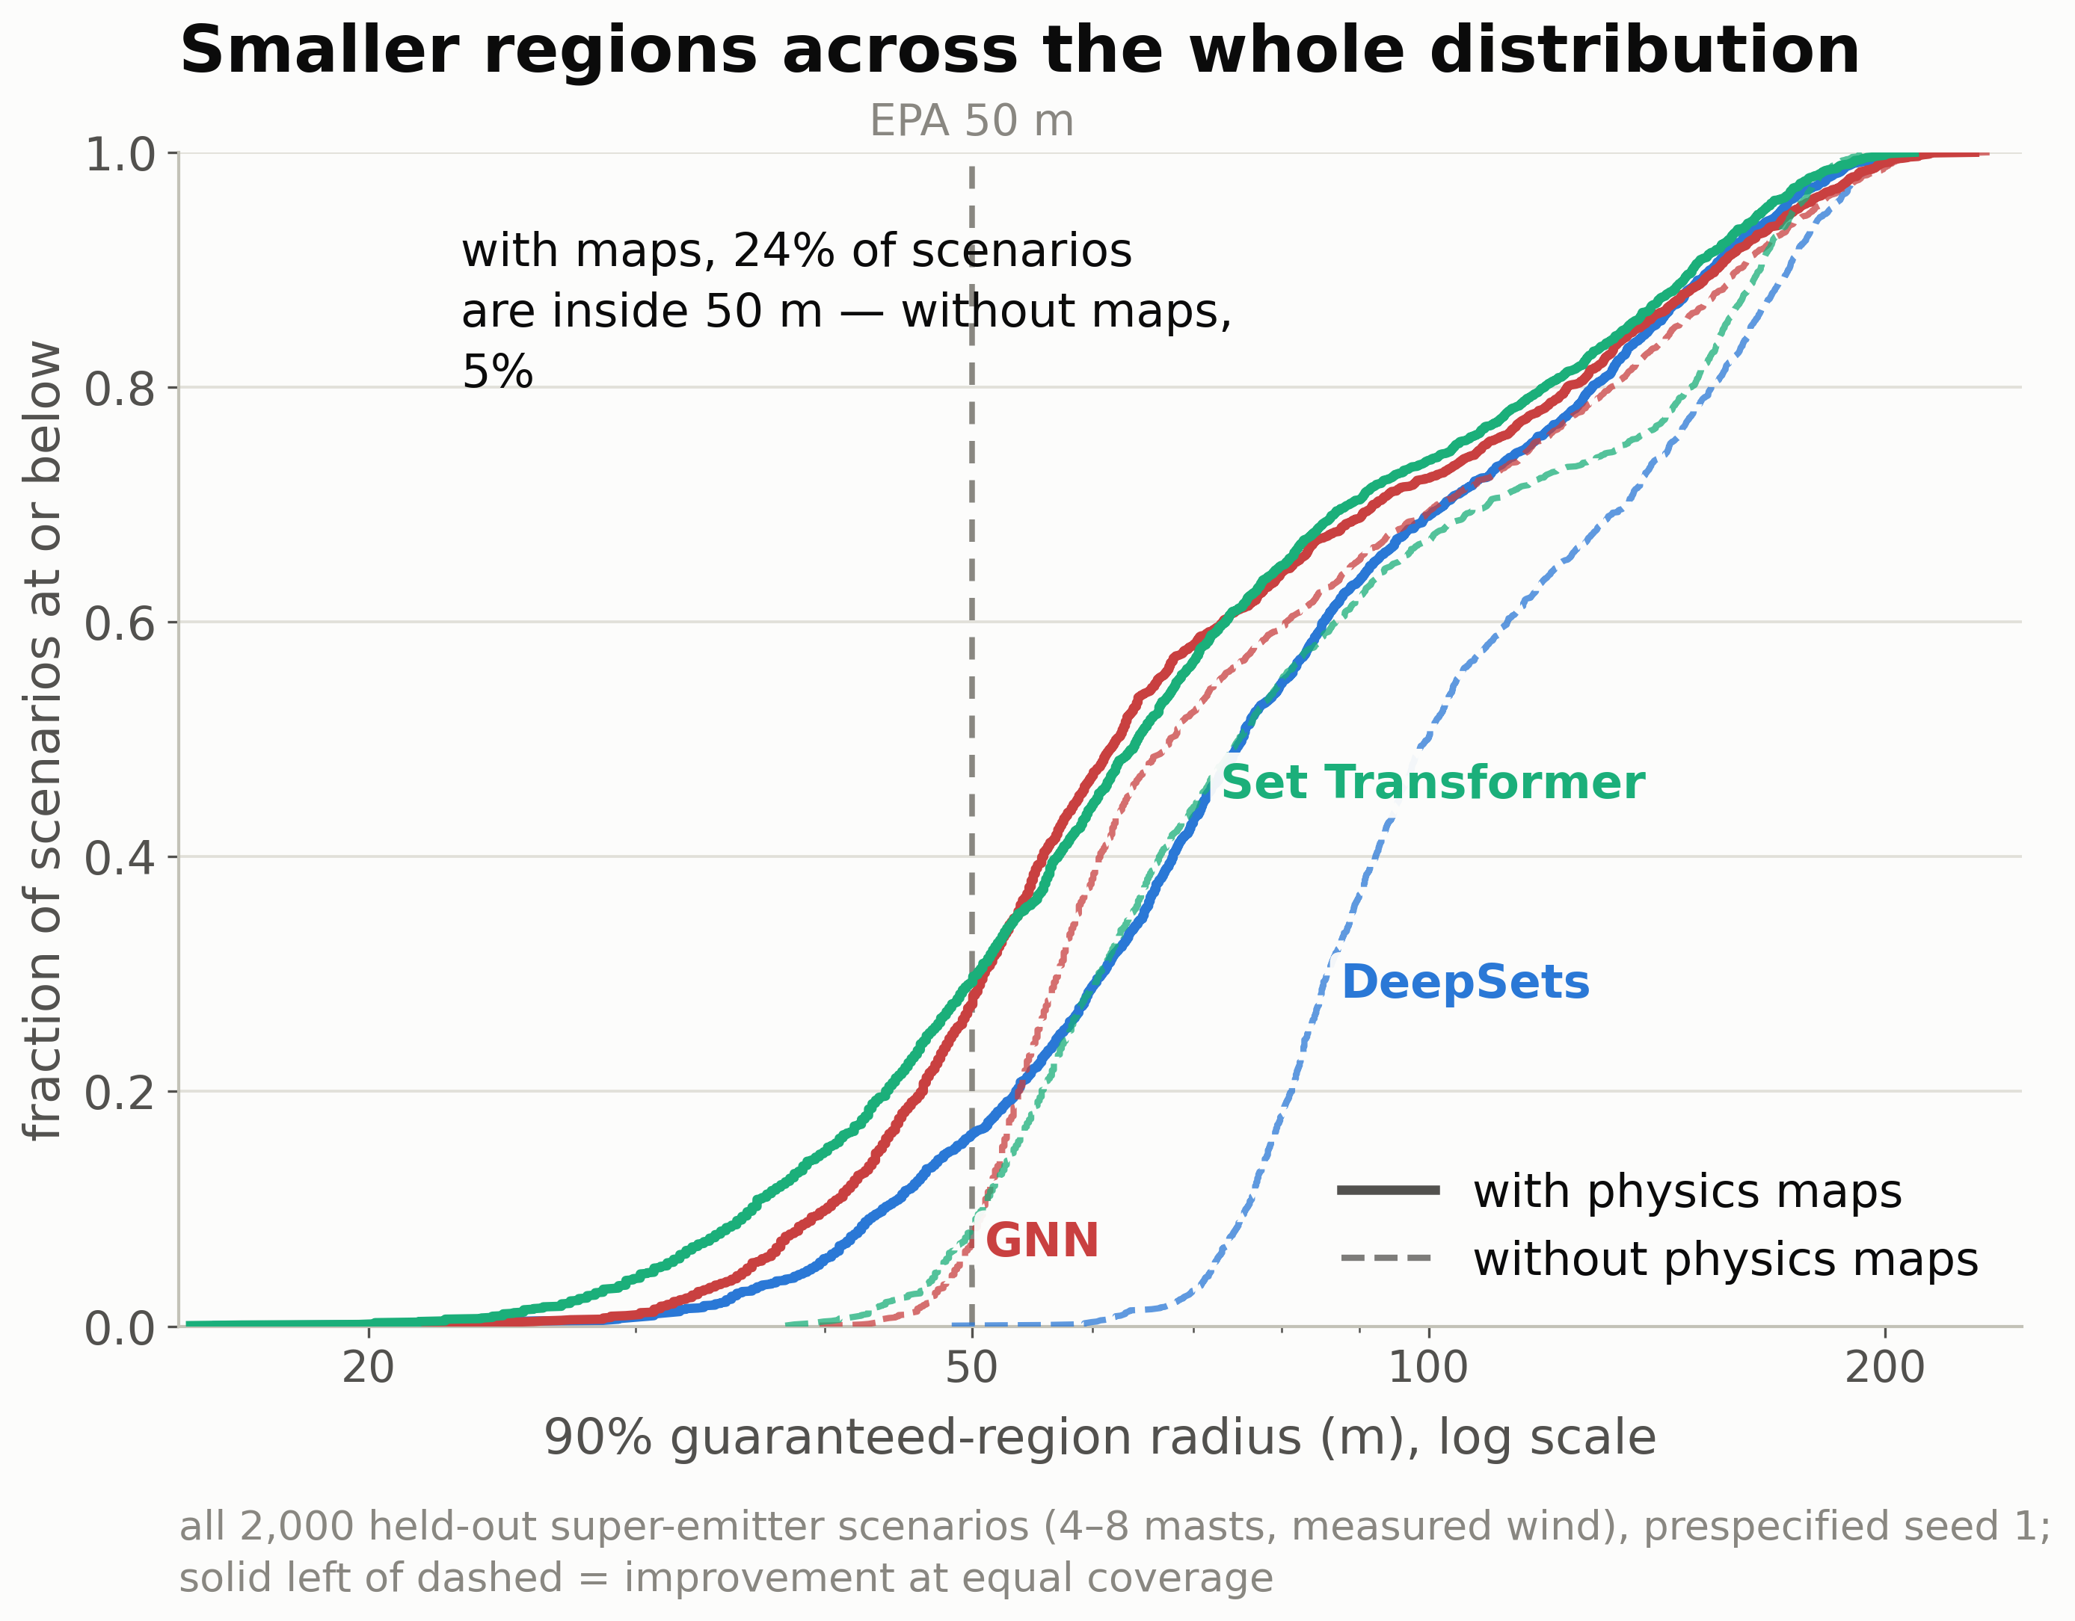
Physics-guided models (solid) sit left of their baselines (dashed) across the entire radius distribution, so the improvement covers easy and difficult scenarios alike. With the maps, 24% of scenarios reach the 50 m facility scale versus 5% without.

Slide 4
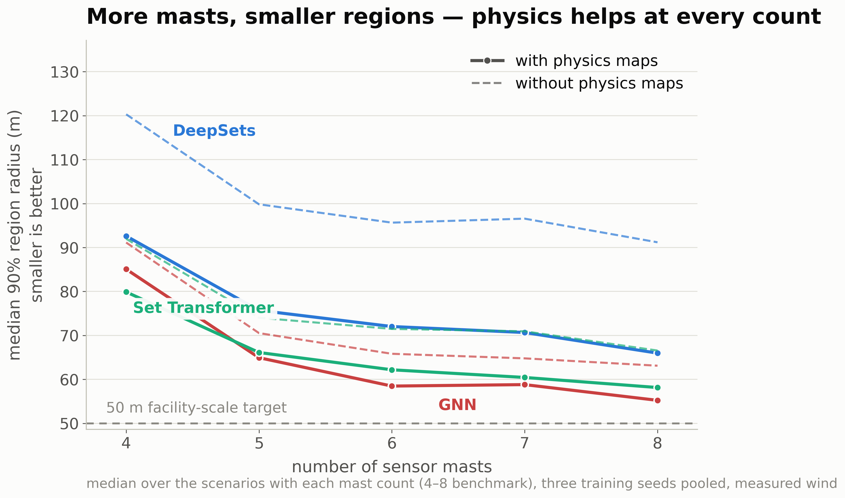
More sensor masts shrink the localization region, with the largest gains from four to six masts and diminishing returns beyond. At every sensor count, the physics-guided models produce smaller regions than their baselines.

Slide 5
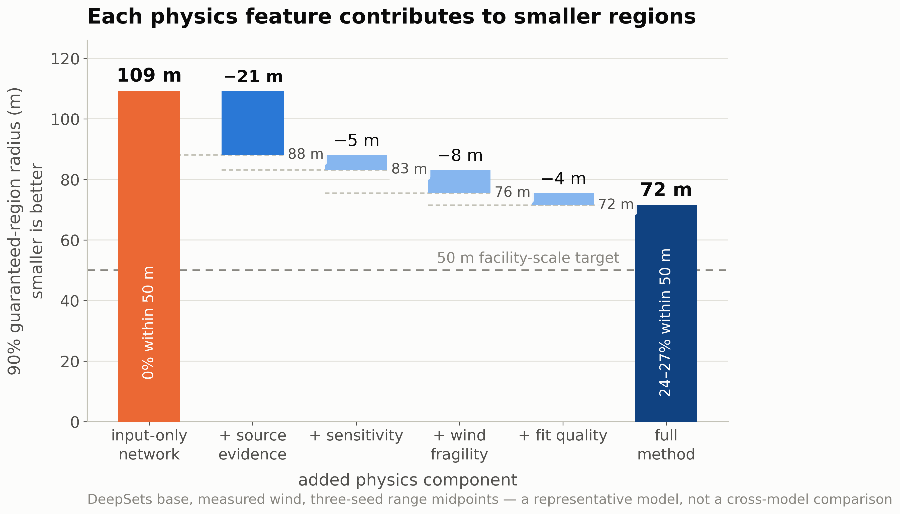
DeepSets component ablation: the source-evidence map provides the largest single reduction in region radius (−21 m), and each added physics component contributes further — the maps carry complementary information.

Slide 6
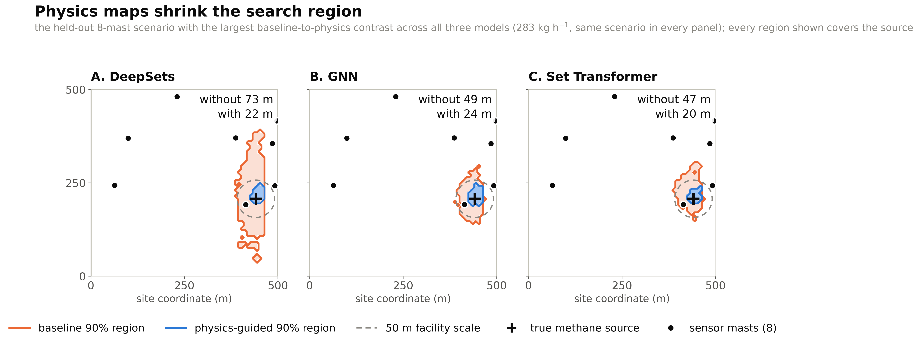
The Region Shrinks Around the Source
One eight-mast scenario, same source for every panel: the physics-guided region (blue) is a fraction of the baseline region (orange) for all three models, and it still contains the true source.

